Slide 1
Bayesian design and analysis of external pilot trials for complex interventions
Duncan T. Wilson, Rebecca E.A. Walwyn, James Wason, Julia Borwn, Amanda J. Farrin

Slide 2
External pilot trials
$\{Pilot trials\}⊂\{Feasibility studies\}$ (Eldridge et al., 2016)
A small version of the planned main study.
Asking the questions: should we do the main trial, and if so, how?
Common quantitative objectives: estimating recruitment rates, follow-up rates, and adherence rates (Avery et al., 2017).

Slide 3
Example - REACH
REACH (Research Exploring Physical Activity in Care Homes): a pilot for a complex intervention designed to increase the physical activity of care home residents.
Feasibility outcomes:
Recruitment (measured in terms of the average number of residents in each care home who participate in the trial);
Adherence (a binary indicator at the care home level indicating if the intervention was fully implemented);
Follow-up (a binary indicator for each resident of successful follow-up at the planned primary outcome time of 12 months);
Efficacy (a continuous measure of physical activity at the resident level).

Slide 4
Example - REACH
Cluster randomised, with 6 care homes per arm.
Progressing to the definitive trial if the progression criteria are satisfied:

Slide 5
Outcome | Red | Amber | GReen
Recruitment | Less than 8 | Between 8 and 10 | At least 10
Follow-up | Less than 50% | Between 50 and 75% | At least 75%
Adherence | Less than 65% | Between 65 and 75% | At least 75%

Slide 6
Any red $⇒$ stop
All green $⇒$ go
Otherwise, modify and then go

Slide 7
Motivation
Can we better formalise how to make decisions after pilot trials? Challenges:
3 decision options, stop / modify / go.
Several attributes of interest, with trade-offs between them.
Complex, small sample models with uncertain nuisance parameters (e.g. an ICC)
$→$ Bayesian approach
Questions:
How should we make progression decisions after a Bayesain analysis?
How can we evaluate a Bayesain pilot design and choose its sample size?

Slide 8
Hypotheses
Identify areas of the parameter space where we would ideally like to stop (R), modify (A), or go (G):

Slide 9
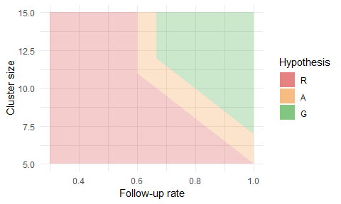

Slide 10
Loss
Three types of errors:
$E_{1}$: proceeding to a futile trial
$E_{2}$: discarding a promising intervention
$E_{3}$: needlessly modifying the intervention or trial design
The loss depeneds on which errors occur, which depends on the decision $d$ and the hypothesis which $ϕ$ lies in.
$$L(d,ϕ)=c_{1}E_{1}(d,ϕ)+c_{2}E_{2}(d,ϕ)+c_{3}E_{3}(d,ϕ).$$
3 descisions and 3 hypotheses $⇒$ 9 possible loss outcomes:

Slide 11
Decision | $ϕ∈Φ_{R}$ | $ϕ∈Φ_{A}$ | $ϕ∈Φ_{G}$
$r$ | 0 | $c_{2}$ | $c_{2}$
$a$ | $c_{1}+c_{3}$ | 0 | $c_{3}$
$g$ | $c_{1}$ | $c_{1}+c_{2}$ | 0

Slide 12
Expected loss
After seeing the pilot data $x$, we choose the action with the best expected loss:
$$\begin{matrix}i^{*} & =arg\min_{i∈\{r,a,g\}}E_{ϕ|x}[L(i,ϕ)].\end{matrix}$$
Let $p_{I}=Pr[ϕ∈Φ_{I}∣x]$, i.e. the posterior probability of hypothesis $I$, given the pilot data. Then,
$$\begin{matrix}E_{ϕ|x}[L(r,ϕ)] & =(p_{A}+p_{G})c_{3}, \\ E_{ϕ|x}[L(a,ϕ)] & =p_{R}c_{1}+(p_{R}+p_{G})c_{2}, \\ E_{ϕ|x}[L(g,ϕ)] & =(p_{R}+p_{A})c_{1}+p_{A}c_{3}.\end{matrix}$$
So, given cost parameters $c_{1},c_{2},c_{3}$ we can make progression decisions after a Bayesian analysis.

Slide 13
Operating characteristics and optimisation
Define three pilot trial operating characteristics:
$OC_{1}(c)$: probability of proceeding to an infeasible RCT
$OC_{2}(c)$: probability of discarding a promising intervention
$OC_{3}(c)$: probability of making unnecessary adjustments to the intervention or the trial design
We want to find costs $(c)$ which minimise these three conflicting objectibes.
Solve the multi-objective optimisation problem
$$\min_{c∈C} \left(OC_{1}(c), OC_{2}(c), OC_{3}(c)\right)$$
where $C=\{c_{1},c_{2}∈[0,1] | c_{1}+c_{2}≤1\}$.
$→$ a set of options for the cost parameters, offering different trade-offs between the three operating characteristics.

Slide 14
Computation
A simple, but computationally expensive, nested Monte Carlo algorithm:
for $j=1,2,…,N$ do
sample parameters $ϕ^{(j)}∼p(ϕ)$
sample pilot data $x∼p(x∣ϕ)$
for $k=1,2,…,M$ do
sample posterior $ϕ^{(k,j)}∼p(ϕ∣x^{(j)})$
estimate $p_{I}^{(j)}≈\frac{1}{M}\sum_{k=1}^{M}{I}[ϕ^{(k,j)}∈Φ_{I}]$ for $I=R,A,G$
get progression descision $i^{(j)}$ based on $c$ and $p_{R}^{(j)},p_{A}^{(j)},p_{G}^{(j)}$
estimate operating characteristics, e.g. $OC_{1}(c)≈\frac{1}{N}\sum_{j=1}^{N}{I}[i^{(j)}=a \& ϕ^{(j)}∈Φ_{R}]+I[i^{(j)}=g \& ϕ^{(j)}∈Φ_{R}∪Φ_{A}]$
(Note that when optimising over cost parameters $c$, we only need to generate one set of $N$ posterior probability samples)

Slide 15
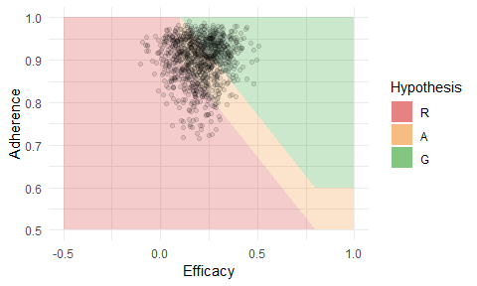
Application

Slide 16
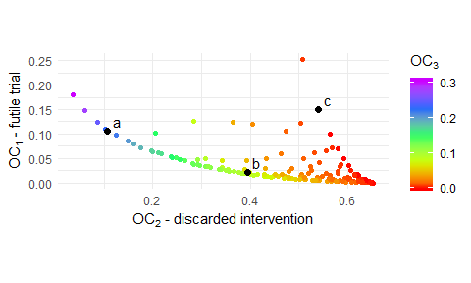
Optimisation

Slide 17
Because we have a 2-D space $C=\{c_{1},c_{2}∈[0,1] | c_{1}+c_{2}≤1\}$, we do a simple grid search. Evaluating 254 cost parameters, 62 were found to be dominated in the Pareto sense.

Slide 18
Example cost parameters
Label | $(c_{1},c_{2},c_{3})$ | $OC_{1}$ | $OC_{2}$ | $OC_{3}$
a | (0.07, 0.9, 0.03) | 0.107 (0.003) | 0.108 (0.003) | 0.232 (0.004)
b | (0.18, 0.58, 0.24) | 0.021 (0.001) | 0.394 (0.005) | 0.08 (0.003)
c | (0.01, 0.29, 0.7) | 0.151 (0.004) | 0.539 (0.005) | 0.002 (0)

Slide 19
Sample size
For cost parameters $c_{1}=0.07,c_{2}=0.9,c_{3}=0.03$ and pilot sample size of $3,6,9$ per arm (bars indicate 95% CIs):

Slide 20
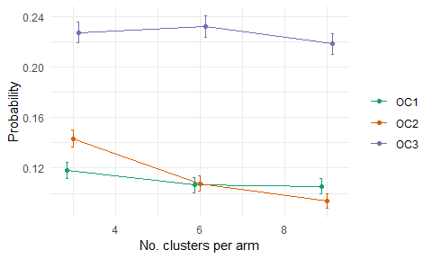

Slide 21
Discussion
Implications:
Bayesian approach can accomodate trade-offs and parameter uncertainty
The proposed method provides a way to formally assess pilot trial sample size
We can start assessing effectivenss using this approach, and thus avoid many futile definitive trials
Limitations:
Need a lot of extra input from the people designing the trial - hypotheses and priors
Computation is slow when out of a conjugate setting - makes sample size choice difficult to evaluate
Pre-specifying an amber region might be difficult
Piecewise constant loss function keeps things simple, but is unrealistic

Slide 22
Thank you | @DTWilson, D.T.Wilson@leeds.ac.uk, https://github.com/DTWilson/Bayesian_pilot

